Slide 1
Arts Analysis Presentation
Presentation of art works :“Letter from Birmingham Jail” by Martin Luther King
“Let My People Go ” by Aaron Douglas

Slide 2
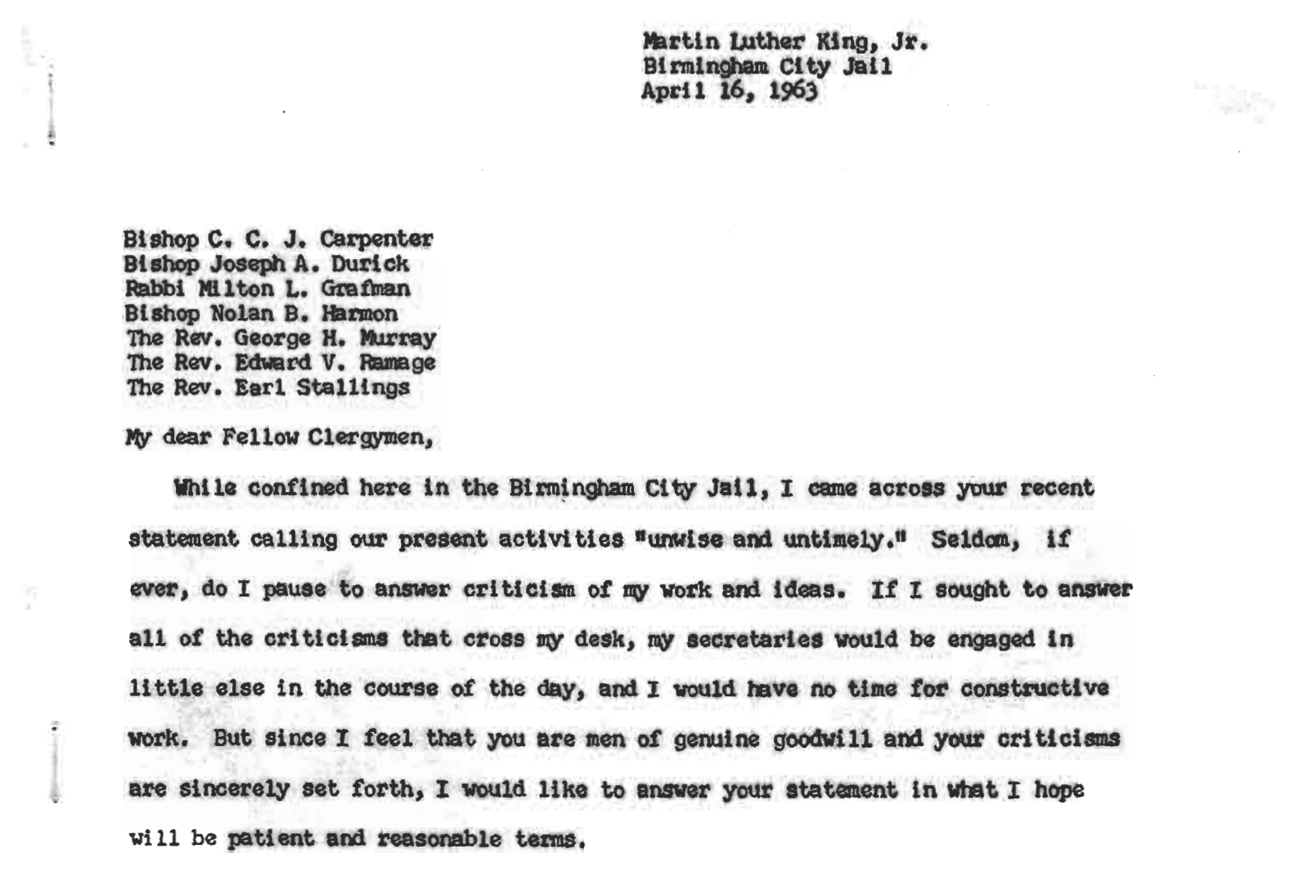
“Letter From Birmingham Jail”
A response to the oppression experienced during “Birmingham Campaign”
Date: April 16, 1963

Slide 3

“Let My People Go” Art
Art at MetCollection Museum
Painted During Harlem Renaissance period
Date: 1935-1939

Slide 4
Themes and Audience
Expression of theme of freedom
Moses stands against the pharaoh soldiers
Theme of oppression
“Let My People Go is a powerful allegory of liberation and enlighten….for African American communities faced with institutional and cultural persecution ”
- Aaron Douglas

Slide 5
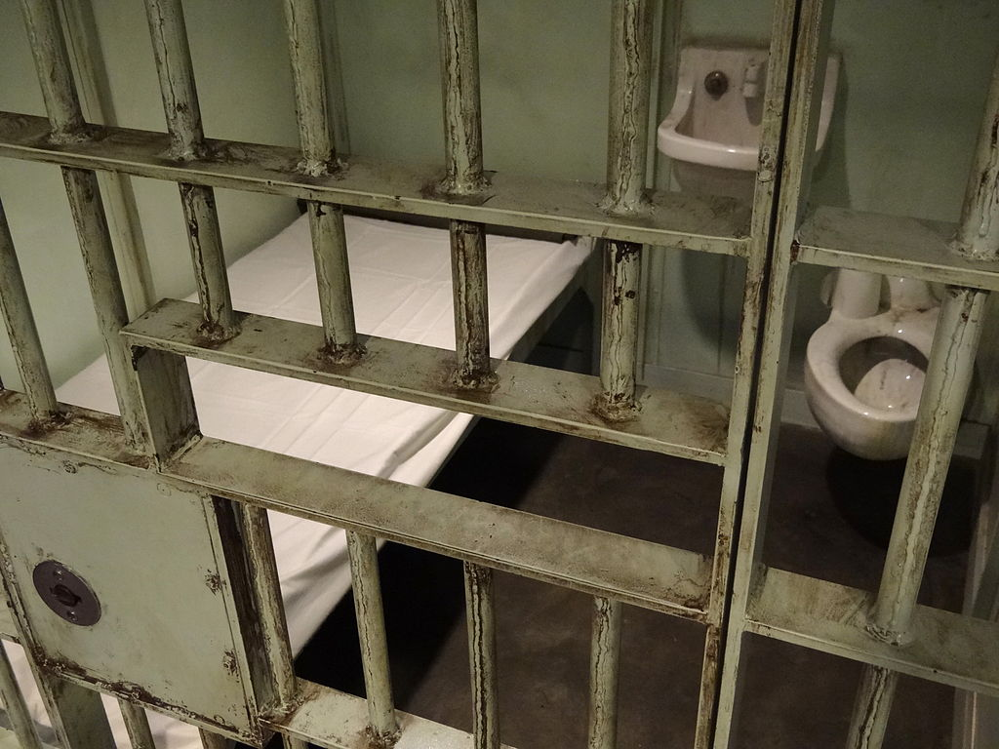
Theme and Audience
Oppression of the poor and people of color
Cruel police brutality
Court injustice
Inequality in church and leadership roles
Dominant White structure controlled everything.
“We will reach the goal of freedom in Birmingham and all over the nation, because the goal of America is freedom”
-Martin Luther King
Martin Luther King cell in Birmingham, Alabama

Slide 6
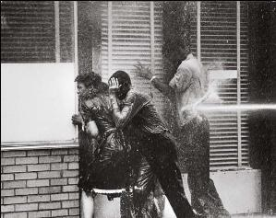
Impact of the Art
Students take peaceful protests to the streets of Birmingham, Alabama
The police meet the protesters with high-pressure water jets from fire hose
Inspired international support for demonstrators

Slide 7
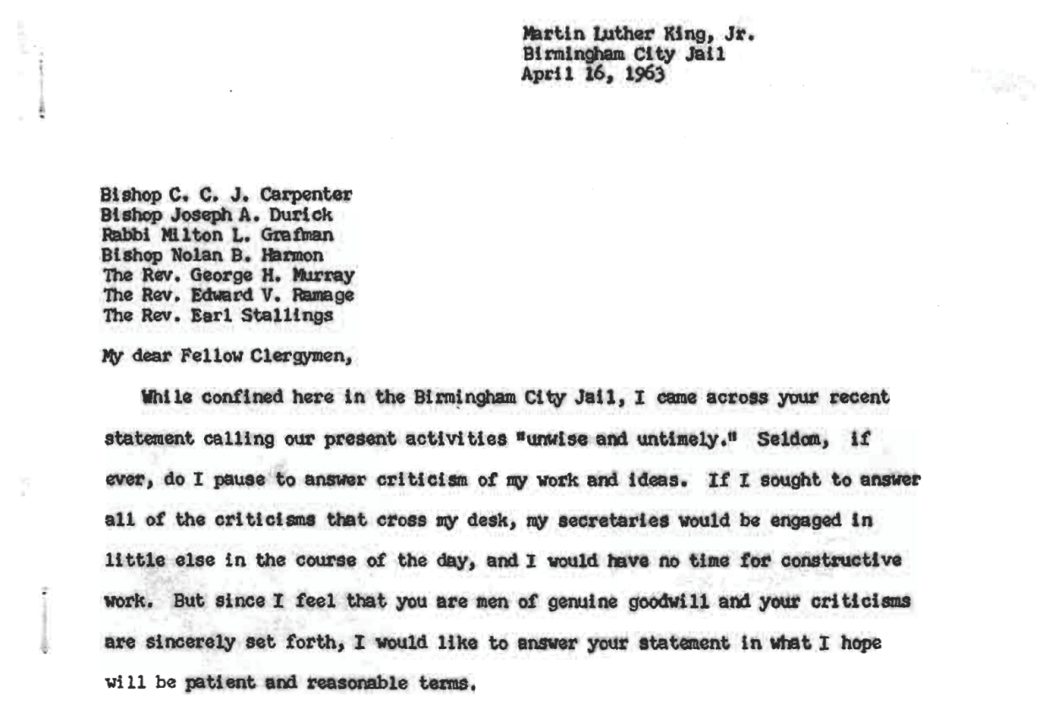
Importance of Humanities
Understanding of culture
Promoting democracy
Sharpening creative thinking
Understanding history

Slide 8
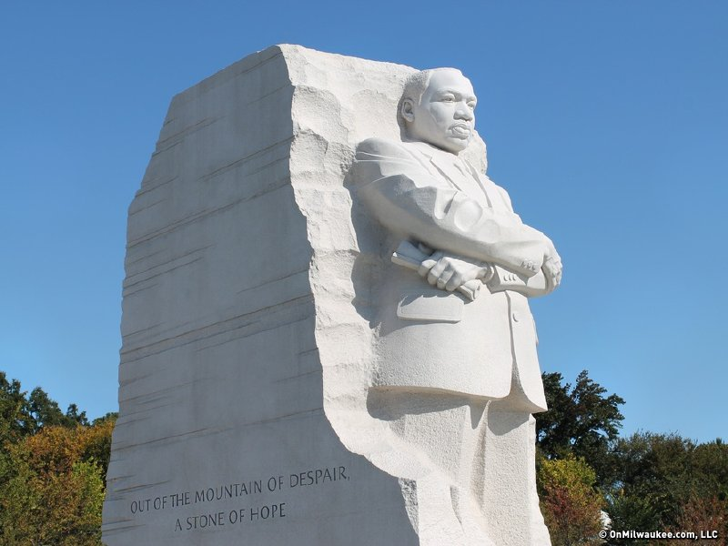
Personal Lessons
Commitment to justice
Freedom does not come on a silver platter
Social Injustices occur exist even in today’s society
Humanities are there to remind us the struggles in the society and hope for a better future
Right is a monument of Luther King with inscriptions from his letter.
“Out of the mountain top of despair, a stone of hope”
-Martin Luther King

Slide 9
Story of Moses and Pharaoh
Lavender and yellow –gold hues depict oppression of the Israelites in Egypt
The light symbolize God’s command
Moses kneeling can be said to be a peaceful negotiation.
Depicts Civil rights era in the 20th century- abolishment, political oppression and segregation.

Slide 10
References
Crenshaw, K. (2018). Demarginalizing the intersection of race and sex: A Black feminist critique of antidiscrimination doctrine, feminist theory, and antiracist politics [1989]. In Feminist legal theory (pp. 57-80). Routledge.
Nussbaum, M. C. (2016). Not for profit: Why democracy needs the humanities. Princeton University Press.
Walton, H., Smith, R. C., & Wallace, S. L. (2017). American politics and the African American quest for universal freedom. Taylor & Francis.

